Slide 1
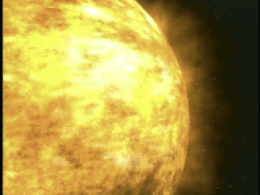



SHINE & AFOSR: AF Research in Solar Physics August 2002
Click on Image to Begin Animation
Paul Bellaire
Program Manager, Space Sciences
Air Force Office of Scientific Research
Air Force Research Laboratory
Approved for Public Release – Distribution Unlimited

Slide 2
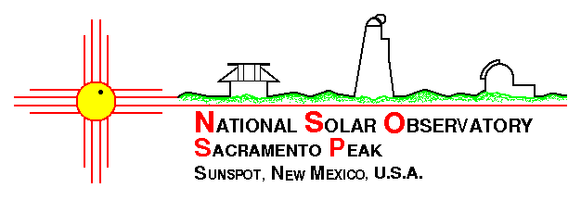






AFOSR Space Sciences:
Supporting SHINE Research Goals
AFOSR routinely transfers research results to operational DoD and NOAA solar physics and space weather forecasters in Boulder, CO, and Omaha, NE
AFOSR shares funding for the Sacramento Peak National Solar Observatory in New Mexico with the NSF Astronomy Division (20% AFOSR, 80% NSF)
AFOSR and two NSF divisions have collaborated on funding the USAF’s AEOS Telescope on Maui for cutting-edge astronomy, astrophysics, advanced adaptive optics instrumentation, and upper atmospheric physics
AFOSR remains a key player (along with ONR) in the National Space Weather Program (NSWP) and the DoD National Security Space Weather Architecture
AFOSR is poised to leverage NASA’s new “Living With A Star” solar physics initiative by sponsorship of two solar physics MURIs and a modeling center at Goddard Space Flight Center
Description
Partnering,
Results,
& Transitions
Future Trends
NOAA SEC

Slide 3
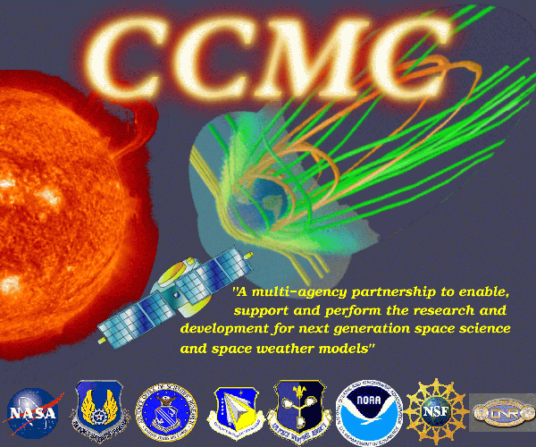
The CCMC: An Innovative
Multi-agency Collaboration
AFOSR enabled a new Space Weather Modeling facility at Goddard Space Flight Center, Maryland
The Community Coordinated Modeling Center (CCMC) for space weather is an innovative multi-agency (USAF, Navy, NASA, NSF, NOAA) collaboration aimed at improving operational USAF and NOAA space forecasting
First modeling transition made to Air Force space operations in late 2001
Description
Partnering,
Results,
& Transitions
Future Trends
http://ccmc.gsfc.nasa.gov

Slide 4
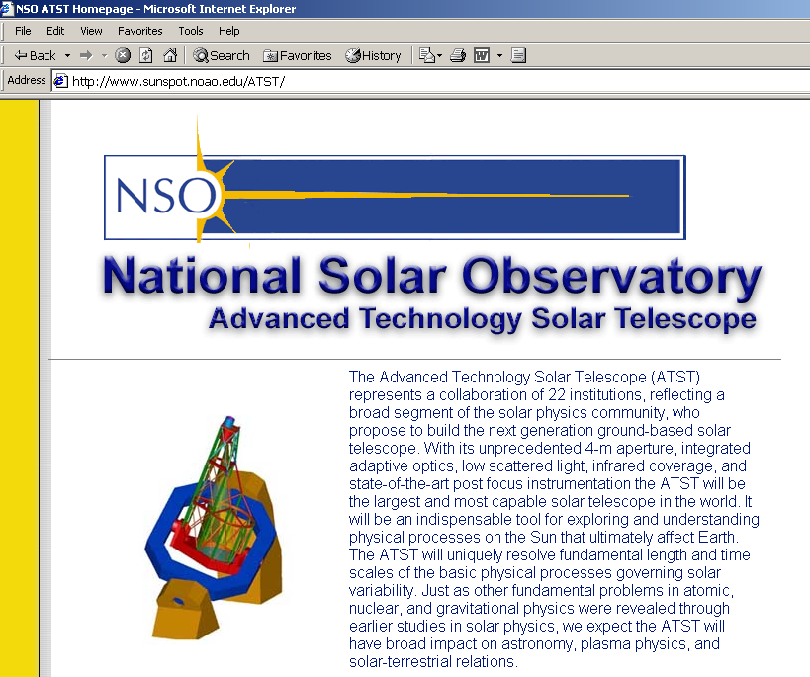
Advanced Technology Solar Telescope [Sponsored by the NSF and AFOSR]
Description
Partnering,
Results,
& Transitions
Future Trends

Slide 5
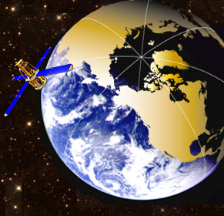
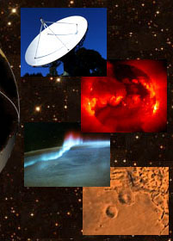


Two New AFOSR MURIs Collaboration with AFRL, ONR, NRL, NOAA
http://solarmuri.ssl.berkeley.edu/index.html
Description
Partnering,
Results,
& Transitions
Future Trends
PI: Dr. George Fisher
UC Berkeley
9-University Team
“Understanding
Magnetic Eruptions
On the Sun and Their
Interplanetary
Consequences”
“Comprehensive Solar-Terrestrial Environment Model (COSTEM)
for Space Weather Predictions”
http://csem.engin.umich.edu/
PI: Dr. Tamas Gombosi
University of Michigan
6-University Team

Slide 6
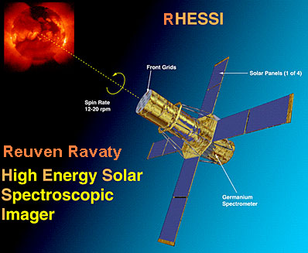
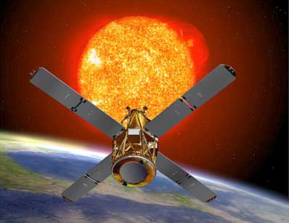
Early MURI Results New Spacecraft Managed by Berkeley Team
MURI TEAM LEVERAGES SOLAR PHYSICS OBSERVATIONS WITH RHESSI
RHESSI offers solar physicists new capability: (1) the first ever X-ray and gamma-ray images of flares from 100 keV to 20 MeV; (2) the first ever nuclear gamma-ray line spectroscopy of solar flares; (3) RHESSI images flares in X-rays with an angular resolution of 2 arcseconds, a factor of three better than previously possible; and (4) RHESSI measures X-ray and gamma-ray spectra with less than 1 keV energy resolution, a factor of 20-40 better than previously possible with scintillation counters.
6

Slide 7
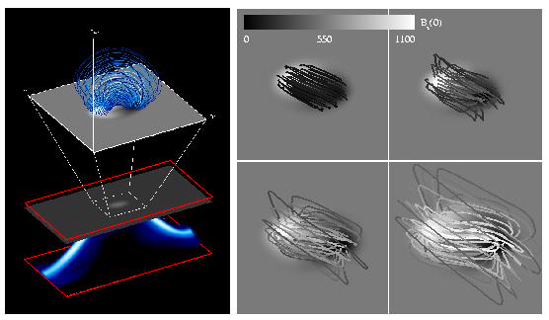
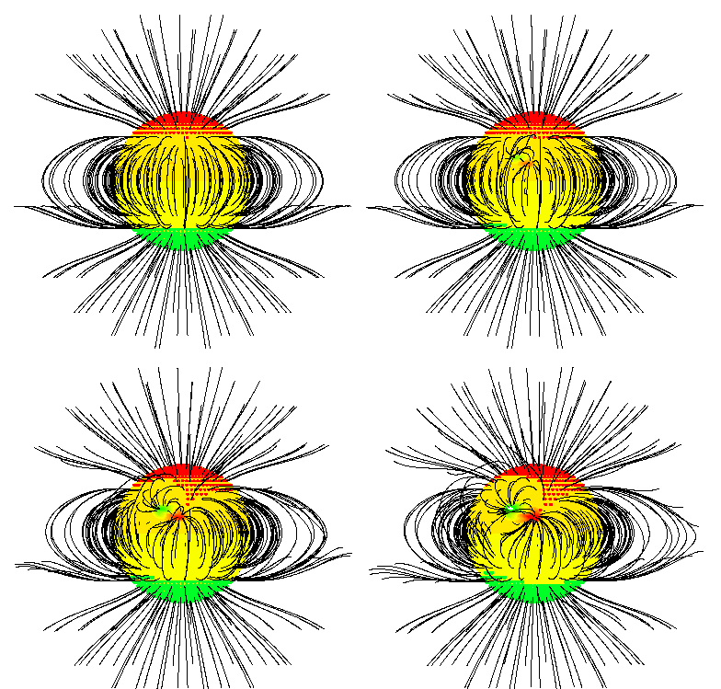
Early MURI Results New Solar Physics Simulations by Berkeley Team
MURI MODELS NOW COMPARED TO GROUND- & SPACE-BASED DATA
The left panel shows a twisted magnetic field loop configuration, computed using anelastic magnetohydrodynamic simulations of solar magnetic flux, emerging through the photosphere and corona (red box). The expanded blue loops at the top of the figure and the four gray-scale panels show computed coronal field line morphology emerging.
The red-green-yellow figure on the right shows modeled field lines (black) and coronal holes (red for positive polarity and green for negative). As an active region emerges, the coronal hole extends further toward low latitudes. Some previous open areas (red & green) become closed (yellow), and field line connections change.
7

Slide 8
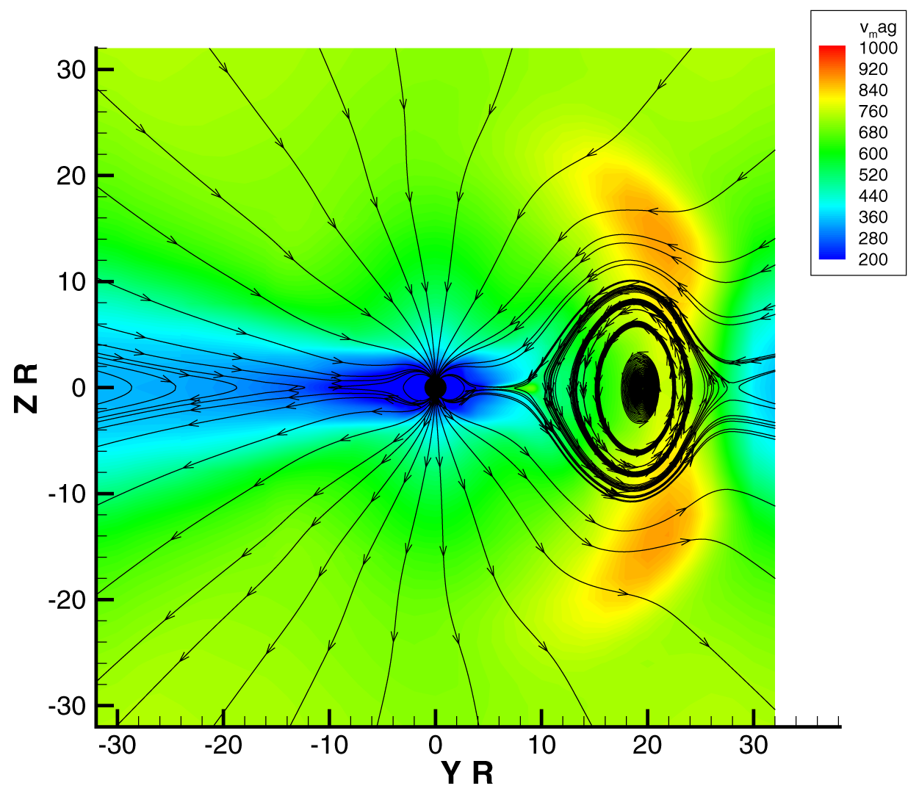
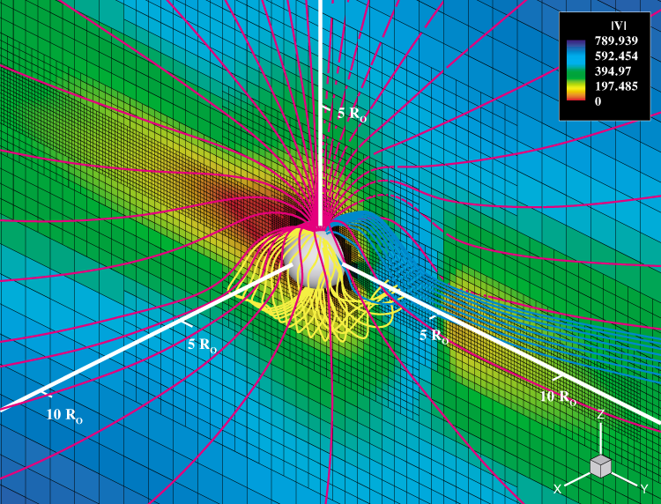
Early MURI Results Adaptive Mesh MHD Modeling at Michigan
GENERATION OF A CORONAL MASS EJECTION (CME) BY FLUX-ROPE ERUPTION
“Flux Rope”
t=0
t=4hr
At t=0, the Gibson-Low (1998) analytic expression for an erupting flux rope is superimposed on a 3D quiet solar wind solution. The interaction of the flux eruption with the background solar wind is calculated with BATSRUS. At t=4hr, the CME expanded to ~25 solar radii (25 R_{s}) and propagated with superalfvenic speed in the background plasma. By this time, the driving plasma “piston” formed a shock, a magnetic loop, and a density cavity.
8

Slide 9
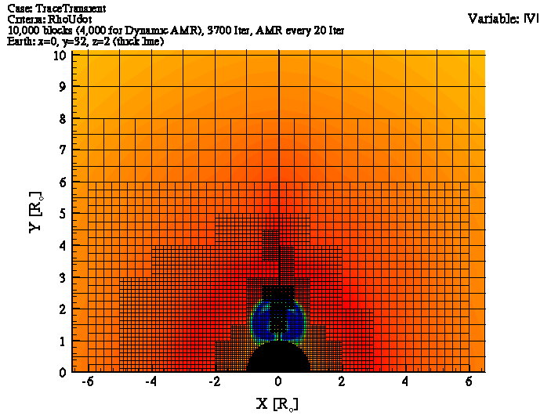
Early MURI Results Adaptive Mesh MHD Modeling at Michigan
SIMULATION OF A CME
Click on image to begin animation
9

Slide 10
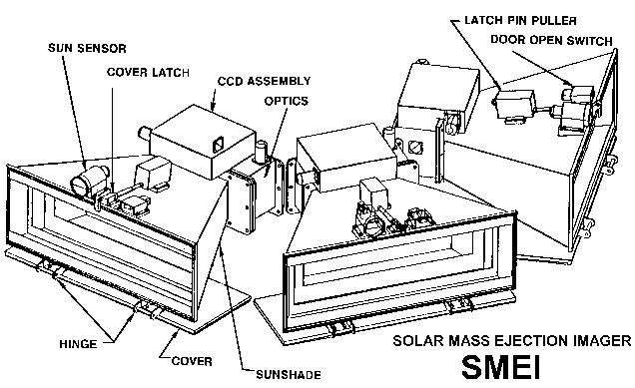
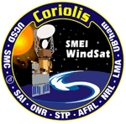
AFRL/VSB & AFOSR Fund SMEI (Solar Mass Ejection Imager)
SMEI DESIGN
Description
Partnering,
Results,
& Transitions
Future Trends
SMEI will image the entire sky in white light once per spacecraft orbit, using baffled camera components with charge couple device (CCD) sensors.
By tracking CMEs from the Sun to Earth, SMEI will make possible accurate 24- to 72-hour forecasts of geomagnetic storms
SMEI will be launched into a sun-synchronous (830 km) orbit as part of the USAF Space Test Program's Coriolis Mission in 2003

Slide 11
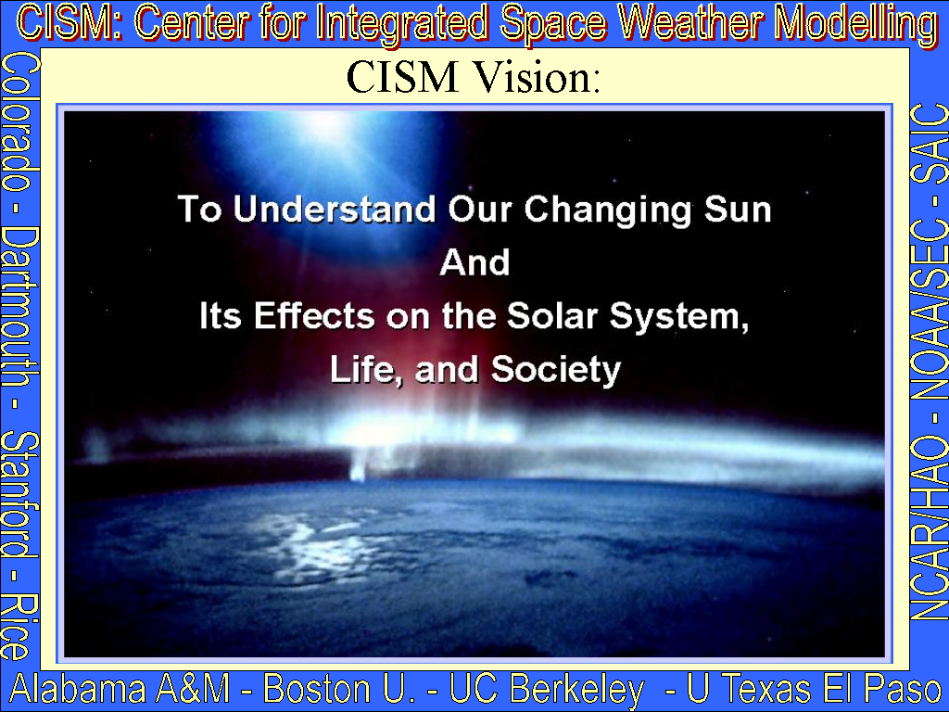

NSF Science & Technology Center Enabled by AFOSR
Description
Partnering,
Results,
& Transitions
Future Trends
http://www.bu.edu/cism

Slide 12


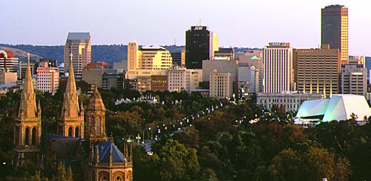
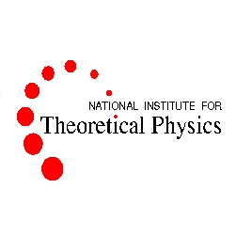
World Institute for Space Environment Research (WISER)
http://www.physics.adelaide.edu.au/wiser/
Description
Partnering,
Results,
& Transitions
Future Trends
WISER, with HQ at Adelaide University in South Australia, is an international network of Centers of Excellence in space physics. WISER promotes collaboration in cutting-edge space environment research and in training of first-rate space scientists. Emphasis is placed on theoretical and computational studies of space plasmas and atmospheres, space data analysis, space weather forecasting, and monitoring the impact of space weather on the Earth's environment and technology. WISER is seeking UN sponsorship, similar to that received by the famed Abdus Salam International Centre for Theoretical Physics in Trieste, Italy.

Slide 13
Future AFOSR Solar Physics Activity
Continue reaching out to foreign partners and leveraging the space weather research programs of Europe and the Pacific Rim
The European Space Agency is trying to follow US footsteps in space weather forecasting, large investments are being made
Australia, Japan, Taiwan and other countries are taking the lead in space research in the Pacific, with Australia proposing a “World Institute for Space Environment Research (WISER)”
Support the development of the US Advanced Technology Solar Telescope (ATST), the replacement for the National Solar Observatory and AFRL’s Sacramento Peak Observatory
Expand research in deep space surveillance at AEOS on Maui, to include advanced adaptive optics for the needs of the ATST
Leverage the NSF’s Center for Adaptive Optics at UC Santa Cruz and their new Center for Integrated Space Weather Modelling at Boston University to ensure the transition of next generation optical sensors and space environment models to operational forecasting
Description
Partnering,
Results,
& Transitions
Future Trends

